Slide 1
Software Project
CECS 544
Spring 2019

Slide 2
Bughound Bug Tracking Software
Bughound is a web-based bug recording and tracking software product
Key Features:
Using web browser, create, edit and update “bug” reports on multiple products
Store error report content in relational tables
Access error report content via SQL
Search for bugs on multiple fields
Facilities to add, delete or update information on program, releases, functional areas, employees

Slide 3
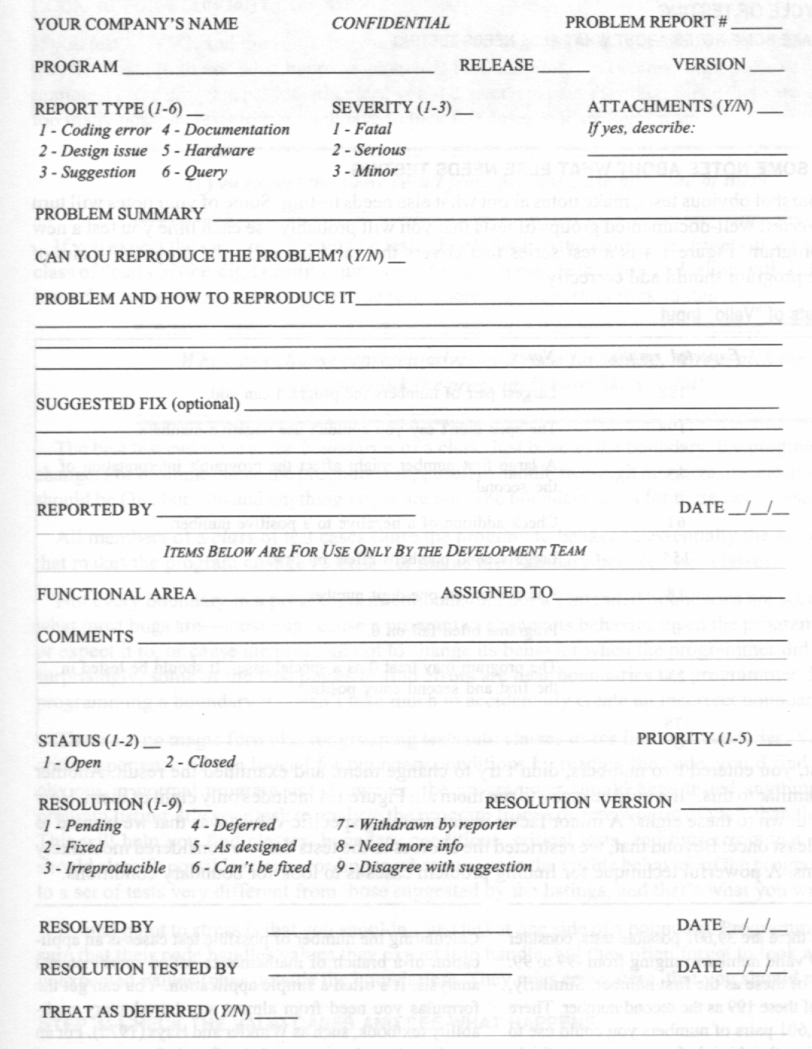
Bughound Content

Slide 4
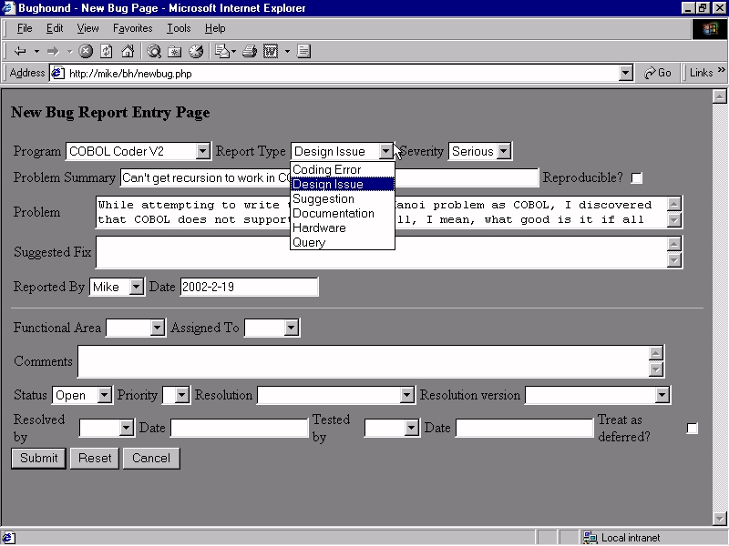
The Report in Software
Notes:
4

Slide 5
Bughound Details
Searchable fields
Program
Report Type
Severity
Functional Area
Assigned To
Status
Priority
Resolution
Reported By
Report Date
Resolved By
Autogenerate bug ID
Attach to report
Images
Memory dumps
Text files
Dynamic fields
Release and version data correspond to program change
One bug per report
Validate input
Export bug data to ASCII or XML

Slide 6
Implementation
Must be web browser based
Must use a sql database for all bug data, program data, employee data, area data
You must HAND CODE the project
You may use netbeans, eclipse, or Visual Studio
It will require server and client scripting such as php or asp and javascript

Slide 7
Due Dates
Feb 21 – ER diagram for all DB elements, UML deployment diagram, use cases for create a new bug report, updating an existing bug report, and management functions for the DB including, adding, updating, or deleting programs, areas, employees
Mar 14 – finished product ready for testing

Slide 8
Contents of the Problem Report
Problem Report Number - unique
Program - your company may write many
Version - Release and Version
necessary because the problem may not be reproducible in other versions
prevents confusion as to whether the bug was from a fixed version or the fix failed
Notes:
8

Slide 9
Contents of the Problem Report
Report Type
Coding Error - program may work as designed
Design Issue - program works as intended, but design is in question
So? AS long as it works, what’s the problem?
Suggestion - just an idea to improve the program
Documentation - doesn’t behave as described in the manual or feature is not documented
Hardware - when the program fails on some specific type of hardware
Query - program behavior is unexpected
Notes:
9

Slide 10
Contents of the Problem Report
Severity - indicates the opinion of the reporter as to the seriousness of the problem
Beizer rates from 1 to 10 (Mild to Infectious)
Fewer levels the better (Minor, Serious, Fatal)
Minor errors tend not to be fixed. But many minor errors affect software quality as seen by users.
Annoyances (too many steps, menus too deep) may be minor to the programmer, but major to users
Notes:
10

Slide 11
Contents of the Problem Report
Attachments - printouts, memory dumps, memos, macros
Problem Summary - one or two line summary. “Program crashes when commission less than 1%.”
Can You Reproduce the Problem? - Yes, No, Sometimes. If the answer is No, many programmers ignore the report. If Yes, you may have to demo for the coders
Notes:
11

Slide 12
Contents of the Problem Report
Problem and How to Reproduce It
explain why it is a problem. Describe all steps and symptoms including error messages
Be careful to describe how to reproduce the problem. Programmers ignore bugs they can’t reproduce.
Better to fail reproducing now, than after you’ve reported the bug
Even if you can’t reproduce it, describe all the steps taken to do so, and report the problem anyway
Notes:
12

Slide 13
Contents of the Problem Report
Suggested Fix - optional. Programmers are not always able to imagine the fix (especially GUI issues)
Reported By - Programmer must be able to contact the reporter if can’t understand the issue. Also used for tacking tester productivity.
Date - date the problem was discovered, not the date of the report. Helps to identify the version
Notes:
13

Slide 14
Optional Contents Problem Report
Functional Area - Everyone uses the same list
Assigned To - group or manager responsible for fixing the problem
Comments - in paper systems, a brief statement on how the problem was fixed. In software trackers, can be a running commentary, discussion, feedback from testers, coders, managers
Notes:
14

Slide 15
Optional Contents Problem Report
Status - Open, Closed or Open, Closed, Resolved
Priority - assigned by manager
Fix immediately
Fix as soon as possible
Fix before next milestone
Fix before release
Fix if possible
Optional
Notes:
15

Slide 16
Optional Contents Problem Report
Resolution and Resolution Version - current status
Pending
Fixed
Irreproducible
Deferred
As designed
Withdrawn by reporter
Need more info
Disagree with suggestion
Duplicate
Notes:
16

